Slide 1
Reading Elective Presentation
By : Munagala Kalyan Ram

Slide 2
CoAP (Constrained Application Protocol)[Link]
It’s a Specialized Web Protocol Proposed by IETF (Internet Engineering Task Force) to be used in constrained environments where nodes of a network have small RAM and processing power.
It has a subset of features offered by HTTP and hence requires a smaller header space . Consists of core methods like GET,PUT,POST. Mapping can be done from CoAP to HTTP by specialised gateways as the functionality is similar.
Utilizes UDP as the transport protocol, allowing for fewer headers in the request/response body and the communication between server and client is asynchronous (pushing messages as they come and not requiring to establish connection). [Non Confirmable Message]
Supports Features like Caching, Proxying, Options (Content-format, Max-Age , etc), dynamic retransmission of messages before timeout . Can have TCP like behaviour by the use of Confirmable Messages (ACK and Code).
Default Port Number is 5683 and must be supported by a server using the protocol to accommodate for Discovery routes. It is used extensively to communicate with IOT running (LwM2M) server, WOT Standardization.

Slide 3
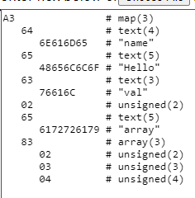
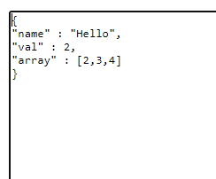
CBOR (Concise Binary Object Representation)[Link]
It is a specialised Internet Standard generated by IETF. It is based on the JSON data model and avoids the need of the addition step of encoding data(base64) to binary format needed by sensors, graphics data, etc.
This is because the CBOR model itself encodes the data in binary format where there is a unique mapping from number, strings, arrays, maps to the binary/hexadecimal format, making it efficient to send large json data.
It is used in LwM2M servers as a part of its security component (OSCORE), in SenML. Example from https://cbor.me/ :

Slide 4
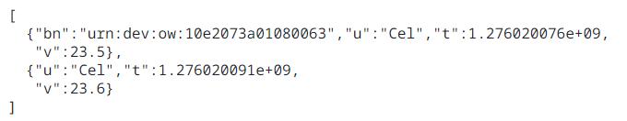
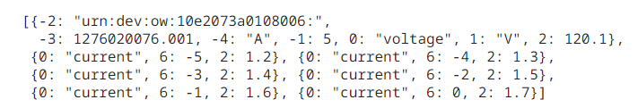
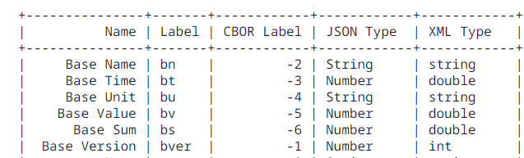
SenML (Sensor Measurement Lists) [Link]
It is a data format for representing sensor measurements as a List of JSON / CBOR objects.
Objective is to allow constrained devices to send a list of measurements as a batch in one response.
Consists of Base Fields(Base Name, Base Time, etc) and Regular Fields (Value, Unit, sum, etc). The Base Field values are represented once in the list and the regular fields are repeated in each object for the different values it can have. It makes the message smaller.
Example : JSON Example : CBOR

Slide 5
IPSO (Internet Protocol of Smart Objects) [Link]
Smart objects are entities or devices that can communicate using the Internet Protocol and IPSO is a lightweight application layer protocol (LwM2M) designed for Internet of Things (IOT).
Objective is to create a common framework for interoperability among IOT devices. It utilizes CoAP as the transfer protocol to support for constrained devices. Also supports other transfer protocols like HTTP, MQTT, etc.
Security[Link]: Communication with a IOT device occurs through a gateway and not always through the endpoint. With multiple gateways, the security of the data present in the IOT device may get compromised. Hence an application layer end-to-end security component is required in addition to the existing Transport Layer Security(TLS).
OSCORE (Object Security For Constrained RESTFUL Environments) is used on top of the transport layer which encrypts the important CoAP options and the message body to maintain security. It utilizes COSE( CBOR Object Signing and Encryption) to encrypt the data and the use of CBOR based encryption allows for smaller overhead.

Slide 6
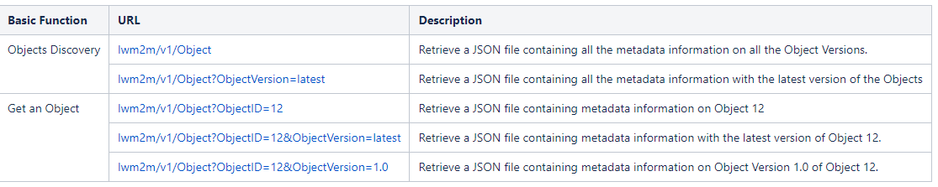
LwM2M (LightWeight Machine-to-Machine) [Link]
It is a device management protocol that communicates with the IOT devices through a remote LwM2M server that performs functionalities like BootStrapping, Diagnostics, Device Config, Extracting Data from devices, etc.
The protocol is designed for constrained devices and utilizes CoAP. To communicate with a LwM2M server a client must be authenticated. This is done by the BootStrap Server that verifies the key sent by the client.
It also handles the registering of IOT devices to the server and provides discovery routes to allow for navigating and extracting the required information from the sensors. Has support for JSON objects by using SenML with CBOR serialization for efficient transmission of sensor data.

Slide 7
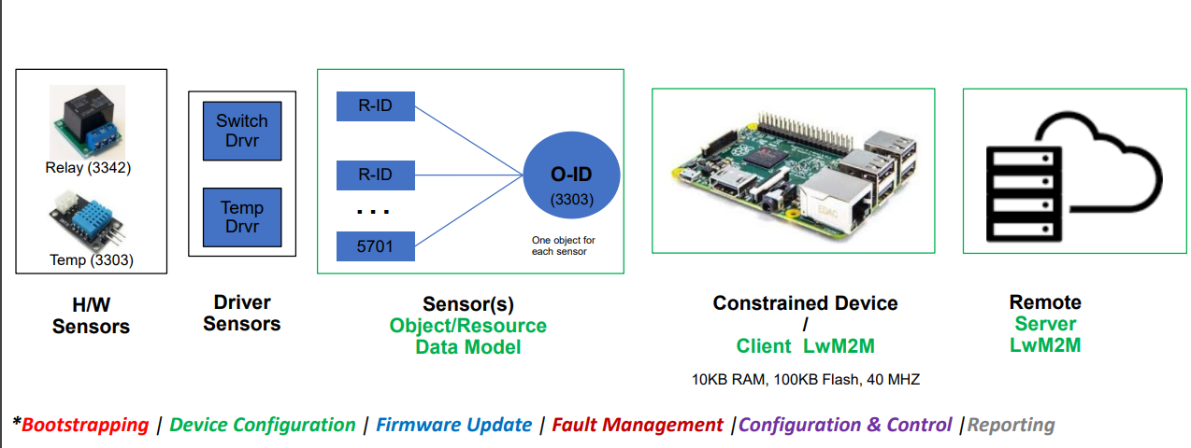
LwM2M object and registry consists of the various object and discovery ids to extract information by specifying the id in the route. LwM2M Registry , Registry + API

Slide 8
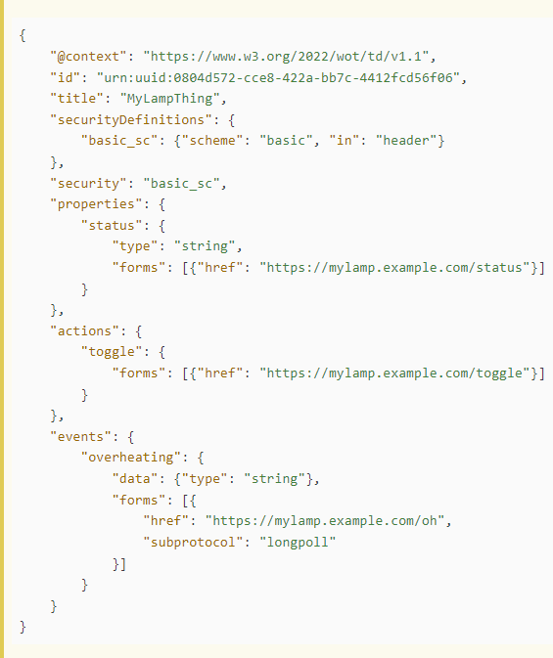
JSON-LD (LD = Linked Data)[Link]
JSON-LD is a lightweight Linked Data format and is based on the JSON format. It provides a way to help json data interoperate at the Web-Scale. Allows an application to start at a piece of linked data and follow the embedded links to other pieces of Linked Data.
It enables interoperability between different systems/devices as it provides links that allow to navigate and extract data from various sources. It is used by a WOT client to process the metadata, interaction affordances (actions, properties, events) sent by a WOT server.

Slide 9
WOT Abstract Architect(Web of Things)[Link]
WOT enables interoperability across IOT devices and application domains and aims to preserve and complement existing IOT standards.
The Link above provides an abstract WOT Architecture based on 30+ use Cases identified like Smart Homes, Smart Cities, Agriculture, HealthCare , etc along with various deployment patterns to allow for cross domain(different usecases) communication (interoperability) .
The Architecture provides various building blocks like WOT Thing Description, Binding Templates , Discovery and more.
A Thing is an abstraction of a physical entity whose metadata and interfaces are described by a Web of Things Description.
The WOT Thing Description comprises of the general meta data, domain-specific metadata, Interaction Affordances (capabilities described as properties, events, actions)
Web Thing Model : https://www.w3.org/submissions/wot-model/ . It is used to describe common capabilities of a set of Things. Also used to provide basic metadata during discovery.

Slide 10
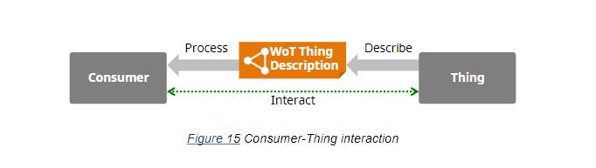
The deployment patterns describes how a device/thing can interact with other controllers, servers, cloud, edge devices, etc.
A Thing can communicate with another thing by the messages they send directly to each other like a control message “turn on “ the electronic appliance, etc.
A user can communicate with a thing using a controller which has the metadata on the features available on the device.
Some devices can’t communicate with the internet, hence edge devices are used which have support to connect with the web and extract the information from the IOT devices.
Digital Twins : A virtual representation of a device that runs on the cloud and is used to provide services to remote clients and test new features.

Slide 11
The Thing presents the WOT Thing Description to allow the consumer to discover and interpret the capabilities of the Thing through the processing that is performed with the help of the JSON - LD format and allows for powerful semantic processing.
Protocol Bindings : It is the mapping from the properties and features of a device to concrete messages for a protocols like CoAp, HTTP and informs the user on how to activate a feature. This is done through Links(for discovery and semantics on device) and Forms (for manipulating state of a device)
WOT Discovery: Describes mechanisms for accessing WOT Thing Descriptions. It provides the user with a method to gain information on the Thing through continuous navigation and takes advantage of the JSON -LD format. 2 Types of discovery mechanisms :
1) Introduction Mechanism : Provides basic information and urls to more important metadata and affordances of a Thing.
2) Exploration Mechanism: Information present in links that a user obtains in 1) and is provided after proper authentication.

Slide 12
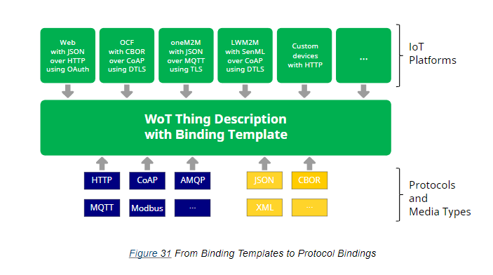
WOT Binding Templates : Enables Interaction with different IOT platforms (LwM2M, OPC UA, OneM2M) , standards ,protocols , and devices with no standard format.
Based on the protocol, media type or platform , a Thing Description is created and a consumer uses this and the Binding Template (Blueprint of the conversion) to get the required information.
Binding Templates : https://www.w3.org/TR/wot-binding-templates/

Slide 13
OneDM SDF (Semantic Definition Format)[Link]
The objective of OneDm is to create a common data model for IOT and IOT devices.
SDF makes use of the existing JSON features and adds upon it.
SDF description : https://datatracker.ietf.org/doc/draft-ietf-asdf-sdf/

Slide 14
Experimenting
Youtube Link of connecting to a microcontroller running as a LwM2M server : LwM2M Tutorial
Official website : Live Objects
Deployed Github Repo : https://leshan.eclipseprojects.io/#/clients
Conversion to Different Data formats in OneDm: https://onedm.org/conversion/

